Slide 1

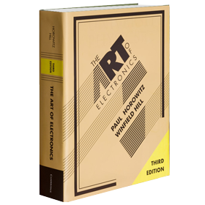
Electronics!!!
Stephen Dunlap, CISSP
stephen.dunlap.ctr@afit.edu
This briefing, presentation, or document is for information only.
No US Government commitment to sell, loan, lease, co-develop
or co-product defense articles or provide defense services is implied or intended

Slide 2
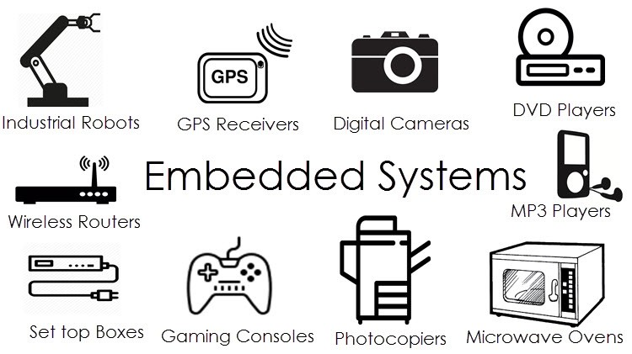

Slide 3
Agenda
Types of embedded systems
PCBs
PCB Components
Input/output – IO
Communication
Programming Interfaces

Slide 4
Types of Embedded Systems
Hardware Only – Digital Logic
Bare Metal Programming
RTOS
Hybrid

Slide 5
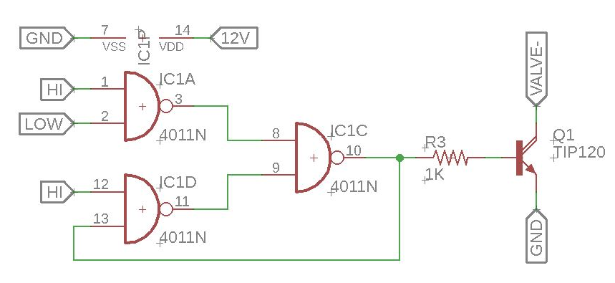
Hardware Only
No software or code
Super fast
Reliable
Types
Circuits – caps, resistors, transistors, etc.
Digital logic – Gate logic
Timer chips
ASIC - Application-Specific Integrated Circuit
FPGA

Slide 6
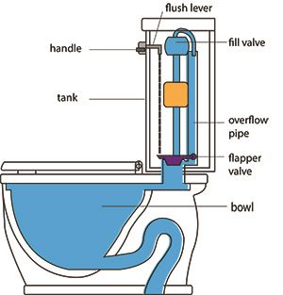
Non-electric example

Slide 7
Water Level Controller

Slide 8

Keurig

Slide 9
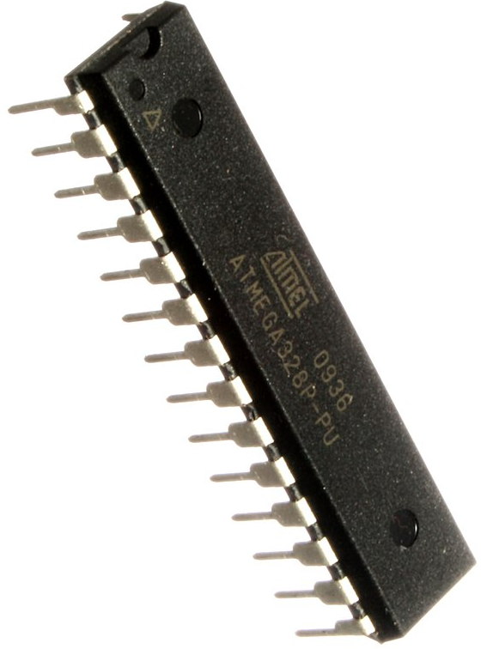
BARE METAL Programming
Typically C (possibly assembly)
Rust is gaining popularity
No operating system
No overhead or scheduling issues
All code controlled by the programmer
Full control of hardware
Interrupts
Timers
Registers
HW-level communication
No OS features:
file system, network stack, etc.

Slide 10
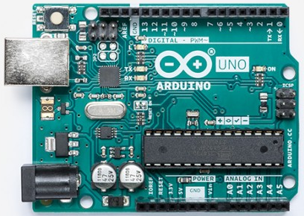
Arduino

Slide 11
Minimum Required Code
#include <Arduino.h>
void setup()
{
// Initialize serial port
Serial.begin(921600);
Serial.print(“Happens once”);
}
void loop()
{
Serial.print("Hello World!\n");
delay(1000);
}

Slide 12
Behind the scenes
int main() {
setup();
while (true) {
loop();
}
return 0; // Never gets here
}

Slide 13
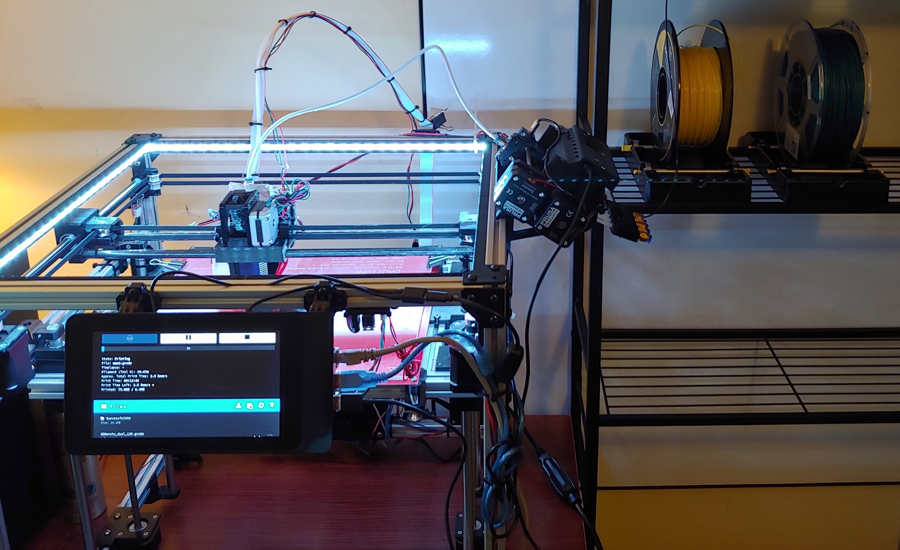
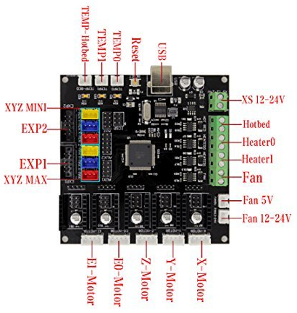
3D Printers

Slide 14
RTOS
Designed to provide OS features with lower overhead and more control over timing
Multitasking/Scheduling
Event-driven – tasks run when an event occurs
Time-sharing – tasks run regularly
Common features:
File systems
Network protocol stacks
Often based on Linux

Slide 15
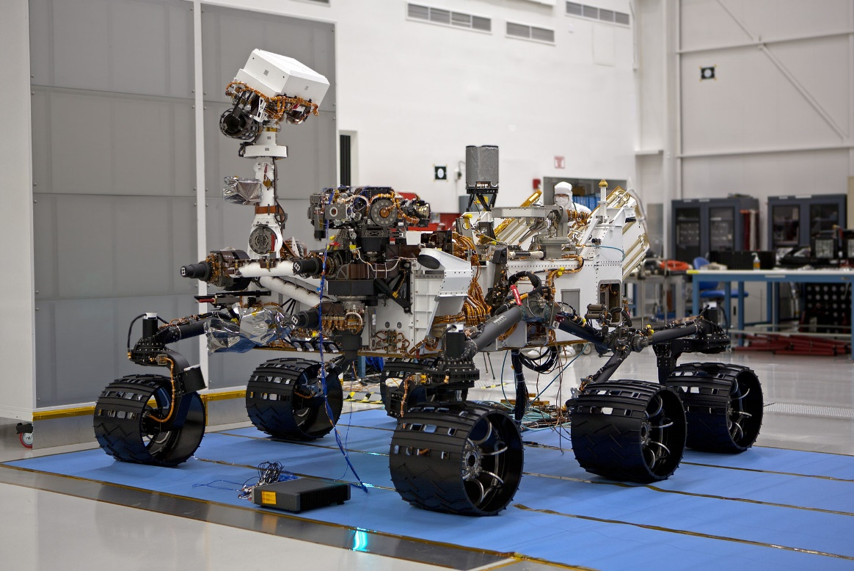
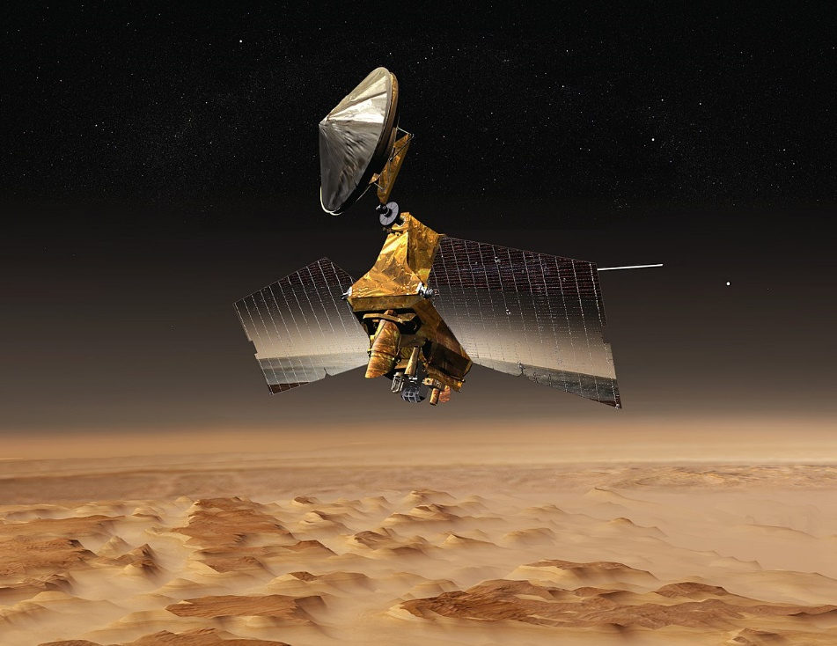
VxWorks
VxWorks supports over 2 billion devices and has been the industry-leading RTOS for over 30 years
Mars Curiosity Rover and Reconnaissance Orbiter

Slide 16
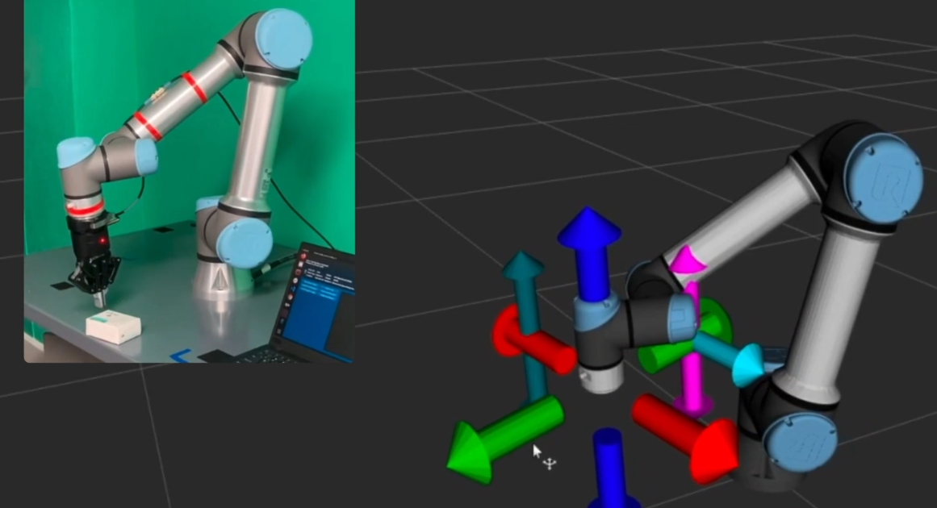
Robot OS (ROS)
https://www.ros.org/

Slide 17
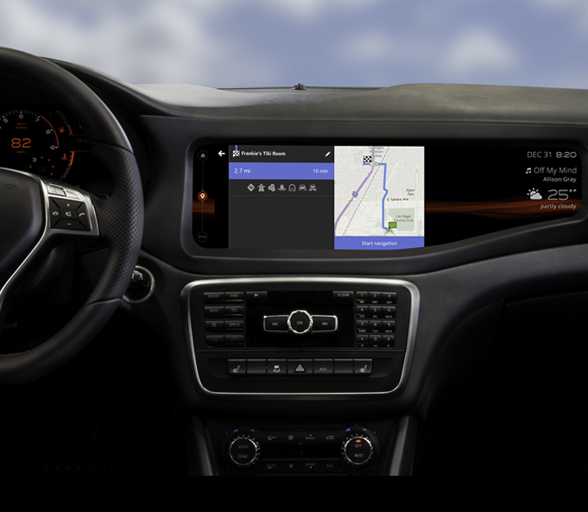
BlackBerry QNX

Slide 18
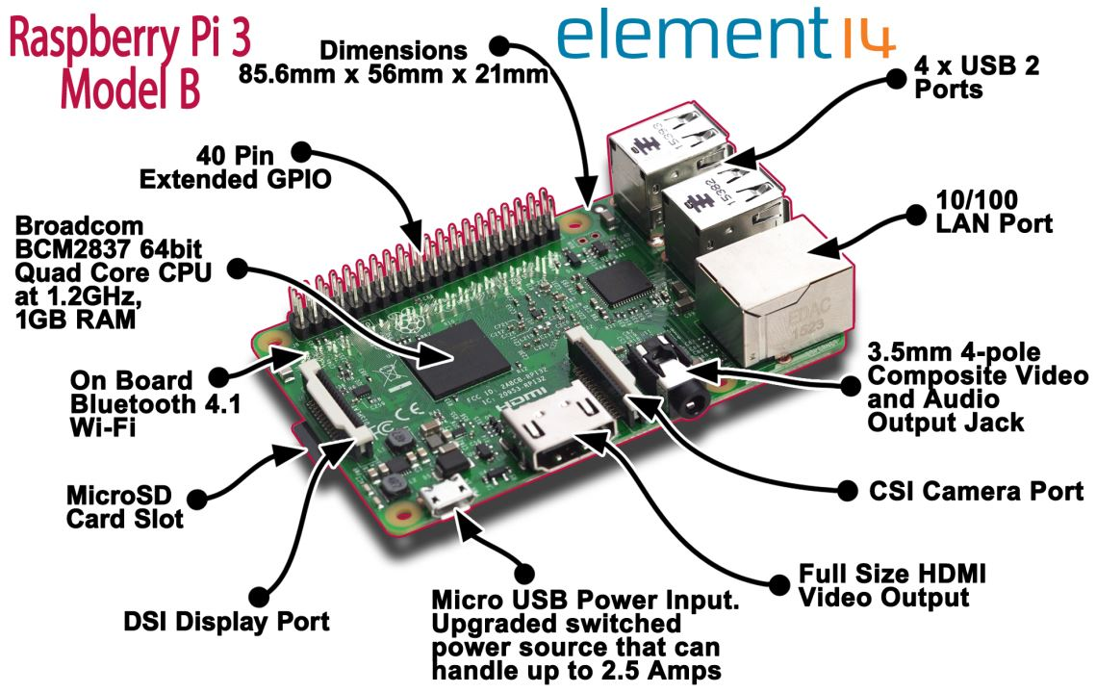
Single Board Computers (Sort of)

Slide 19
HYBRID
Combination of hardware, bare metal and RTOS
Every embedded system is different
Multiple processors on one board
Processors and FPGAs on same board
Custom ASICs
Multiple boards connected

Slide 20
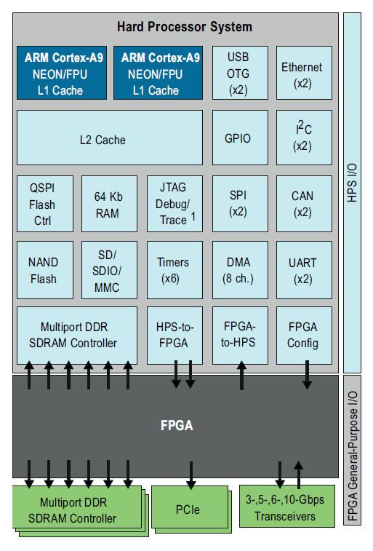
SoC
Altera SoC FPGA
Arm Processor
FPGA
RAM
Flash
Many other things

Slide 21
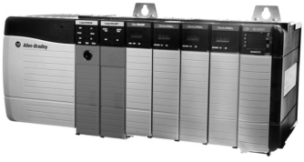
PLC

Slide 22
PCBs
Resistor
LED

Slide 23
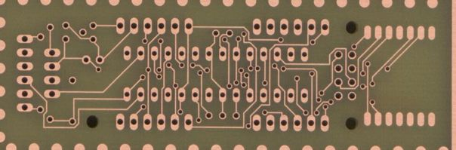
PCBs

Slide 24
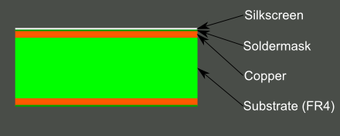
Layers

Slide 25
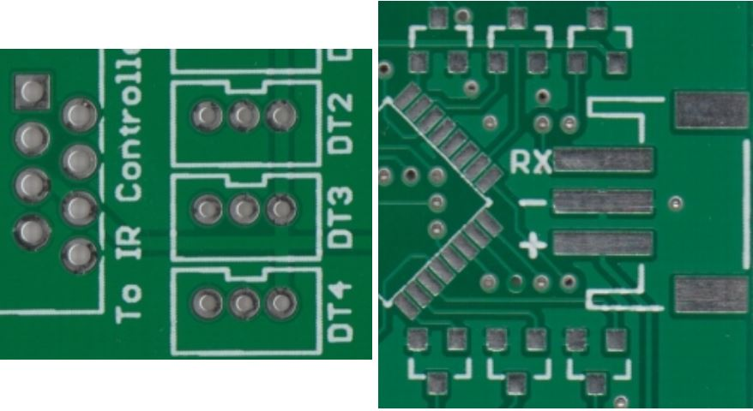
Through Hole vs Surface Mount

Slide 26
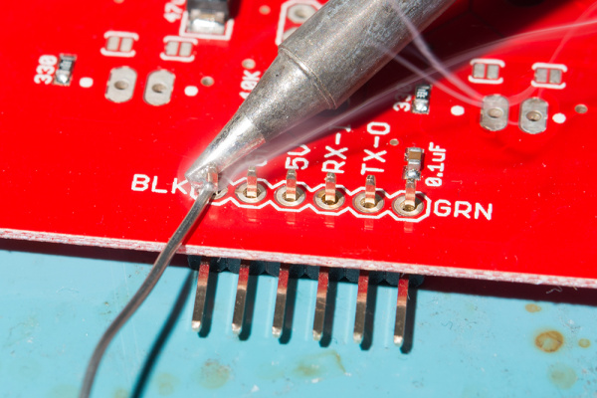
Soldering - Through hole

Slide 27
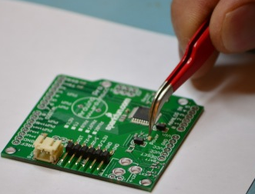
Soldering - SMD

Slide 28
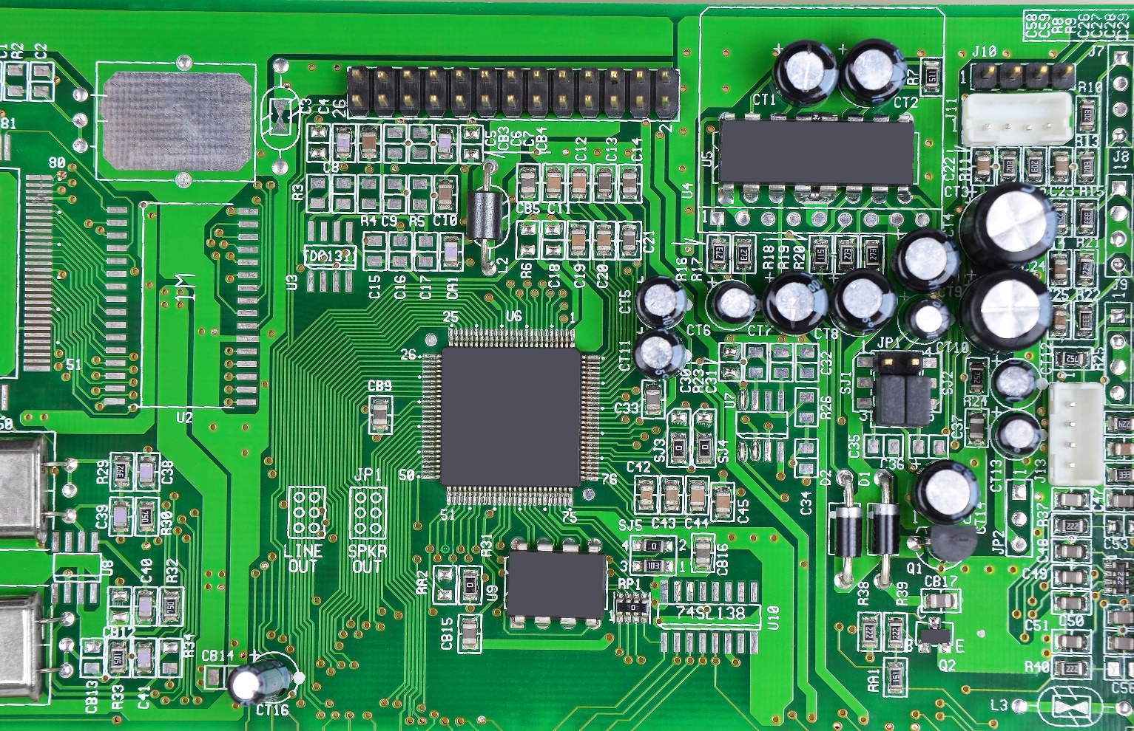
Hardware Analysis

Slide 29
Interesting Components
Processors and Microcontrollers
Volatile memory
SRAM
Nonvolatile memory
Flash
EEPROM
SD Cards – not kidding
Connectors
USB
UART
JTAG

Slide 30
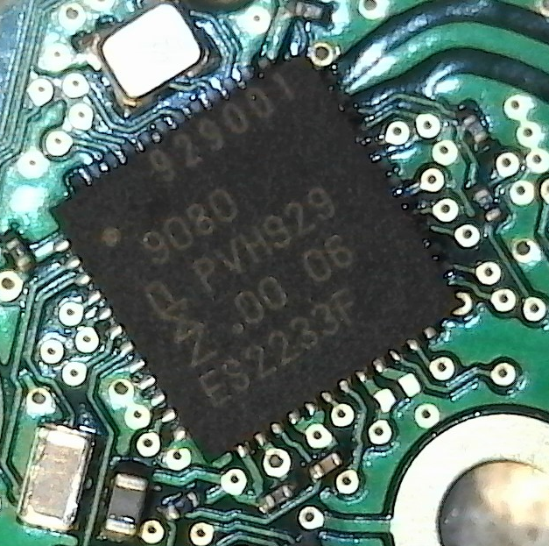
Datasheets

Slide 31
Questions

